Slide 1

High Level Project Planning
For Global Game Jam 2025 – Bellevue College
Chris Klimecky
Head of Production / CPO, Midwest Games

Slide 2


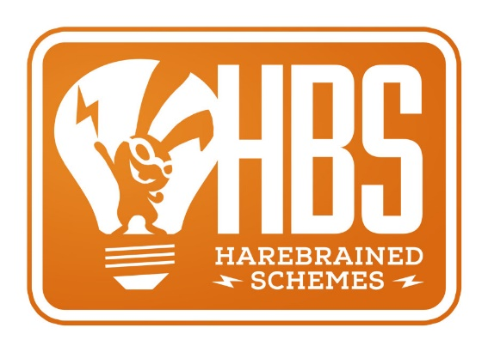















My Background

Slide 3
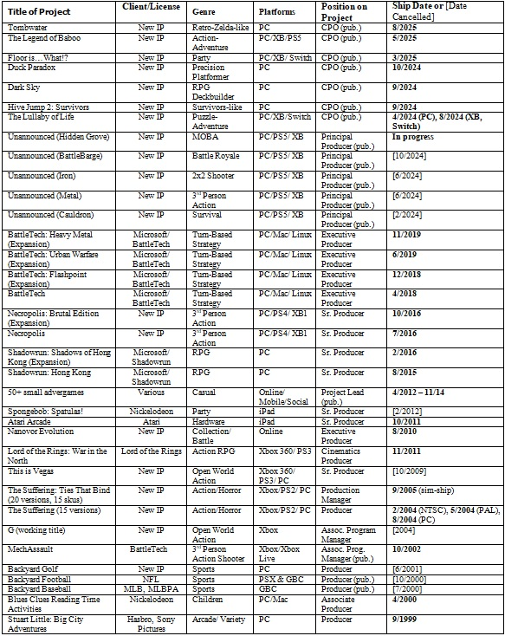
Project History
50+ Titles!
(Not all listed)

Slide 4
Goal
Align around terminology, techniques, and mindset for high level project planning.
AKA Help you prepare for success at GGJ!

Slide 5
Topic Breakdown
Development Framework
  Common ground and language
  Industry (non-)standards
  DF Model
Production Phase Timing
  How are production phases laid out on a timeline?
  What are the various considerations for different size projects?
  Examine a hypothetical dev cycle example

Slide 6
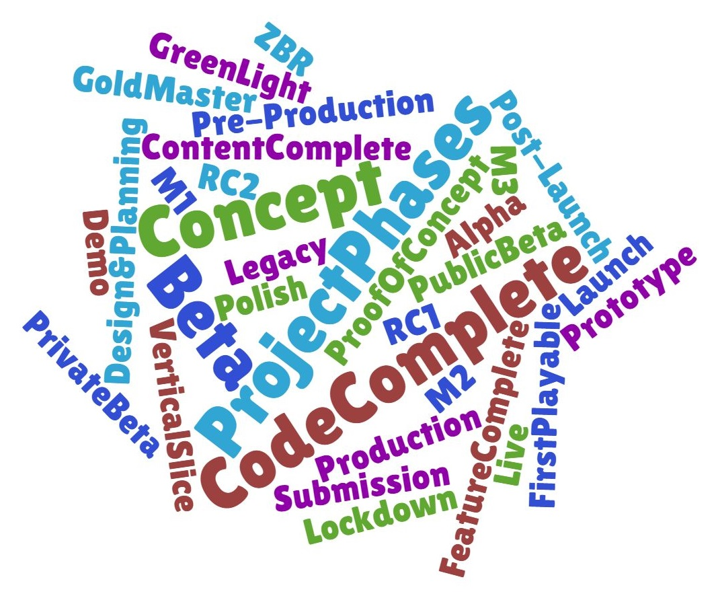
Terminology

Slide 7
Typical Issues
Phase, milestone, build names interchangeable
  Alpha phase with Alpha 1, Alpha 2 milestones and Alpha builds
End goal is the next phase
  “End goal of Alpha is Beta” or a Beta build
Pre-Production might include Concepting, Prototyping, and/or Vertical Slice phases
Post-Launch is its own project/schedule
  Often a different team altogether

Slide 8
Dev Framework
Phase
PRE PRODUCTION |  |  | PRODUCTION |  |  | LIVE
Concept | Design & Planning | First Playable | Feature complete | Content complete | Polish | Post Launch | Legacy
What is it? | Define it! | Prove it! | Build it! | Finalize it! | Improve it! | Grow it! | Squeeze it!
Exciting concept and compelling business case. Clear market opportunity which fits the portfolio strategy. | Concept defined and a plan for how we build the game and how we bring it to the market. | Vertical slice to set final quality targets. Pipeline and plans verified. Knows what to build, how to build it, and it can be done. | All key features are playable in game. Entire game can be played from start to finish in rough form. | All content is represented (MVP). Only bugs and polish remains. | Game ready to be released and the publishing team is ready to bring the game to market. | Drive engagement and generate revenue. | Back catalog - generate revenue
What is the game? What is the market opportunity? What is the business case? How does it fit in the company strategy? | What is the game design? Is it fun to play? How will we build it? | Do we have a credible plan to build the game? What do people think of the game? How will we market this? | Are risks to launch being managed? Is development progressing as planned? | Can we evaluate all parts of the game? Are we hitting our quality targets? | Is the game ready for customers? | What is next for our customers? How do we improve the experience? How do we grow the game and business? | Where do players go next? How can the game/franchise continue to contribute to the company strategy?
Stage
Green Light
Gate1
PoC
Gate2
Gate3
Alpha
Gate4
Beta
Gate5
Launch
Gate6
Legacy
Vertical Slice
Tagline
Goals
Questions to answer

Slide 9
Phase Considerations
Pre-Production
  Documentation vs. Prototyping
  Concept Art
  Proof of Concept - what are you trying to prove and who are you proving it to?
Production
  How many milestones?
  Scope management is critical
  Defining “Feature Complete” and the Alpha quality bar
  Polish and other necessary “launch” buffer time

Slide 10
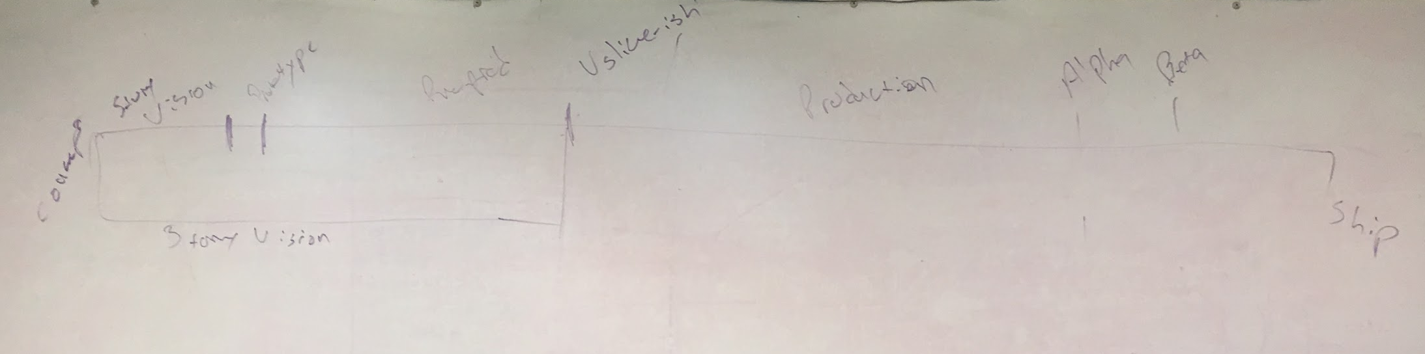
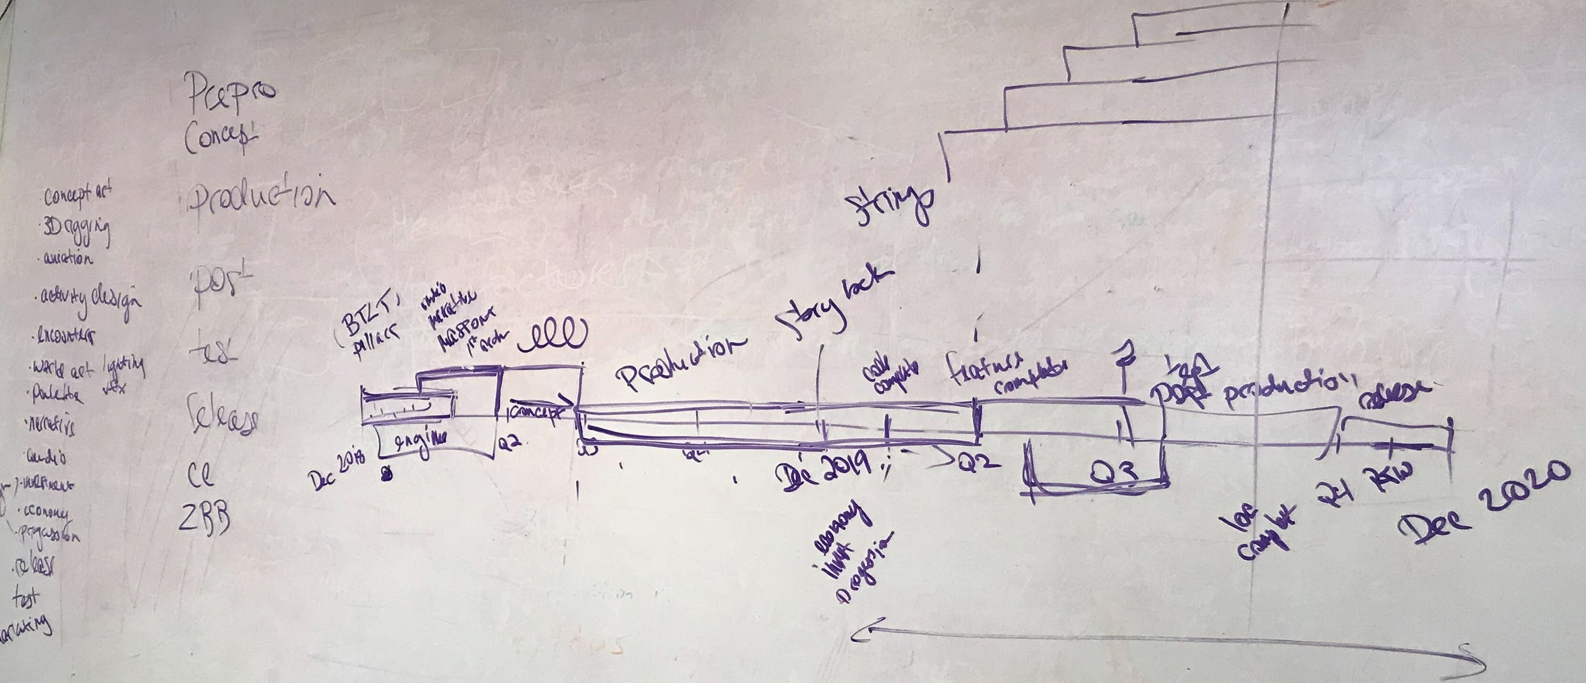
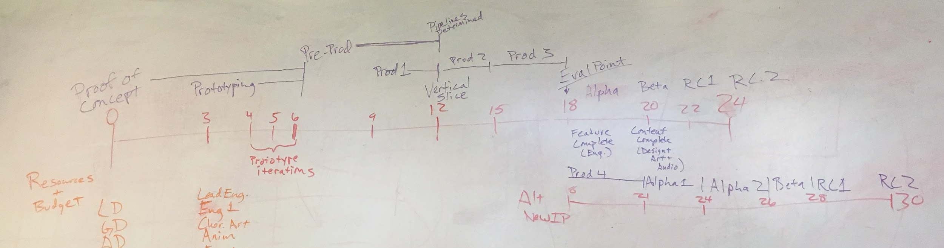
Project Phase Timing

Slide 11
Project Phase Timing
Pre-Production
Production
2
4
6
11
3
7
Start
Green Light
PoC
Vertical Slice
Alpha
Beta
Launch
Concept
Design & Planning
1st Playable
Feature Complete
Content Complete
Polish

Slide 12
Production Phase Breakdown
4
4
3
3
3
1
2
1
Vertical Slice
M1
M2
Alpha
Beta
ZBR
RC
Cert
Launch
Feature Complete
Content Complete
Polish

Slide 13
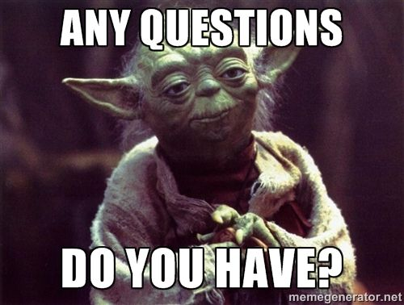
The End
Chris Klimecky
Head of Production / CPO, Midwest Games
Connect:
Linkedin.com/in/chrisklimecky
Email:
cklimecky@gmail.com

